Slide 1
MARKET BASKET INSIGHTS

Slide 2
INTRODUCTION
Market Based Insights:
Provides deeper market knowledge and understanding, clarity through fresh perspectives, and recommendations for effective business decision-making (innovation initiatives, pricing, messaging, benchmarking, etc.)
Interprets data in narrative form that adds value and/or incites specific action
Uses a wide range of data streams and a multi-disciplinary approach to identify near and long-term (1-3 years) growth and innovation strategies as well as a clear path to implementation
Determining new opportunities among existing clients, and participating in new business initiatives
Collaboration with GTM leaders in strategic planning and investment effort

Slide 3
WHAT IS MARKET BASKET ANALYSIS?
Market basket analysis is a data mining technique used by retailers to increase sales by better understanding customer purchasing patterns. It involves analyzing large data sets, such as purchase history, to reveal product groupings, as well as products that are likely to be purchased together.
The adoption of market basket analysis was aided by the advent of electronic point-of-sale (POS) systems. Compared to handwritten records kept by store owners, the digital records generated by POS systems made it easier for applications to process and analyze large volumes of purchase data.
Implementation of market basket analysis requires a background in statistics and data science, as well as some algorithmic computer programming skills. For those without the needed technical skills, commercial, off-the-shelf tools exist.

Slide 4
DESIGN THINKING
Data Source: Choose a dataset that contains transaction data with lists of purchased products.
Data Preprocessing:Load and clean the dataset, handling missing values and duplicates and Convert the data into a suitable format for association analysis,
Association Analysis:Utilize the Apriori algorithm to identify frequent item sets and generate association rules.
Insights Generation: Interpret the association rules to understand customer behavior and cross-selling opportunities.
Visualization:Create visualizations to present the discovered associations and insights.
Business Recommendations:Provide actionable recommendations for the retail business based on the insights

Slide 5
CODING
import numpy as np
import pandas as pd
import matplotlib.pyplot as plt
from mlxtend.frequent_patterns import apriori
from mlxtend.frequent_patterns import association_rules
dataset.isnull().sum()
ataset['Itemname'] = dataset['Itemname'].str.strip()
linkcode
dataset.dropna(axis=0, subset=['Itemname'], inplace = True)
dataset = dataset.drop(columns= ['CustomerID'])
dataset.isnull().sum()
dataset.dtypes
dataset['BillNo'] = dataset['BillNo'].astype('str')
dataset = dataset[~dataset['BillNo'].str.contains('C')]
dataset['Country'].value_counts()
dataset.shape
basket = (dataset[dataset['Country'] == 'Germany' ].groupby(['BillNo','Itemname'])['Quantity'].sum().unstack().fillna(0))
linkcode
basket
def encode(x): if x <= 0: return 0 if x >= 1: return 1basket = basket.applymap(encode)basket.drop('POSTAGE', inplace = True, axis = 1)basket
frequent_items = apriori(basket, min_support = 0.007, use_colnames= True)
rules = association_rules(frequent_items, metric = 'lift', min_threshold = 1)
linkcode
rules.head(100)
rules = rules.sort_values(by='lift', ascending = False)
linkcode
rules

Slide 6
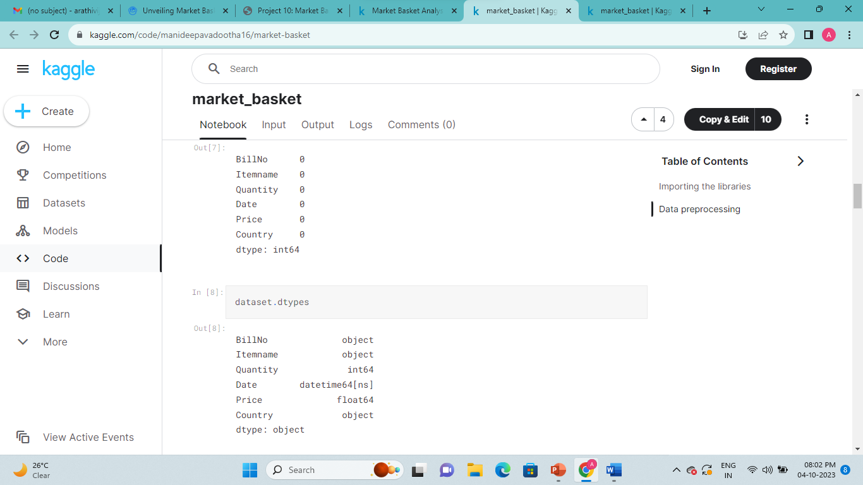
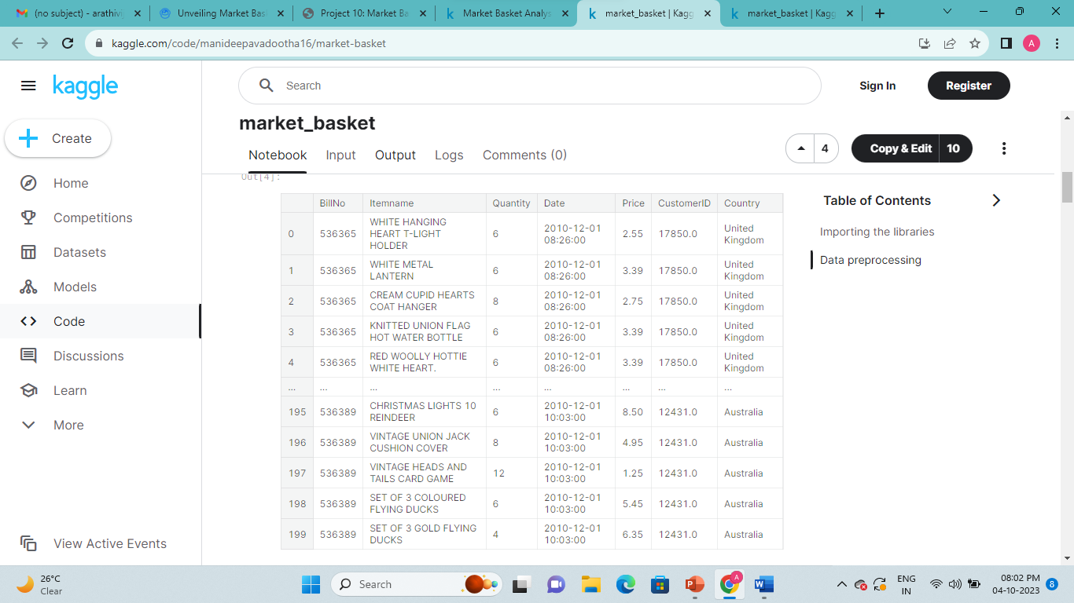
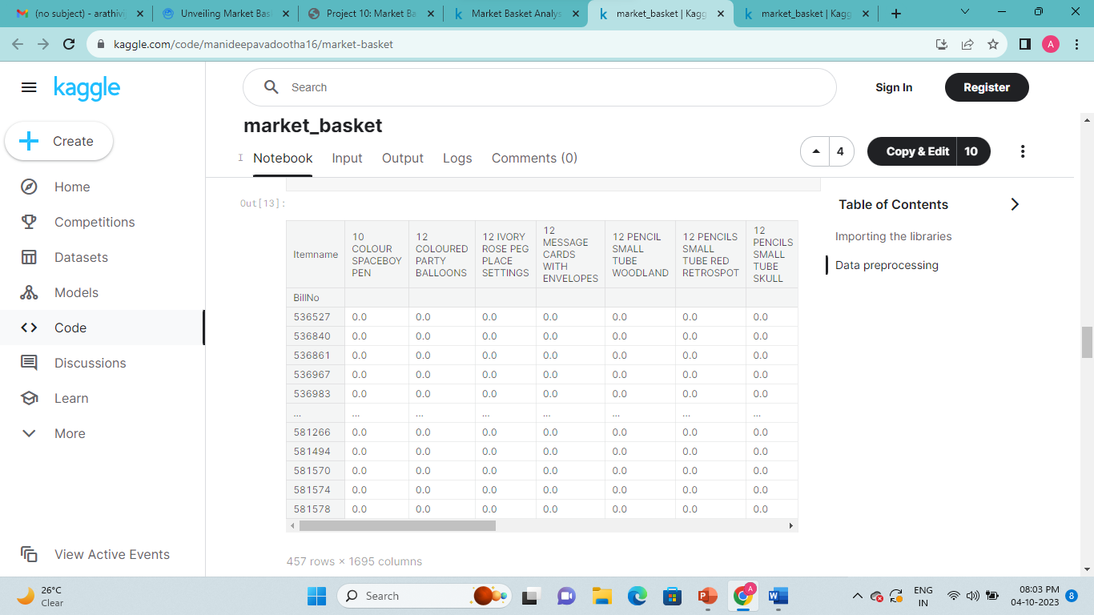
OUTPUT

Slide 7
CONCLUSION
Market basket analysis is a data mining technique that analyzes patterns of co-occurrence and determines the strength of the link between products purchased together. We also refer to it as frequent itemset mining or association analysis. It leverages these patterns recognized in any retail setting to understand the behavior of the customer by identifying the relationships between the items bought by them. To put it simply, market basket analysis helps the retailers know about the products frequently bought together so as to keep those items always available in their inventory.
The source from which these patterns are found is the vast amount of data that is continually collected and stored. With frequent mining of the item set, it becomes easy to discover the correlation between items in huge relational or transactional datasets. It considerably helps in decision-making processes related to cross-marketing, catalog design, and consumer shopping analytics.

